Slide 1
DS4023（2025 Fall） Machine Learning Department of Computer Science Beijing Normal-Hong Kong Baptist University

Slide 2
Chapter 3: Supervised Learning

Slide 3
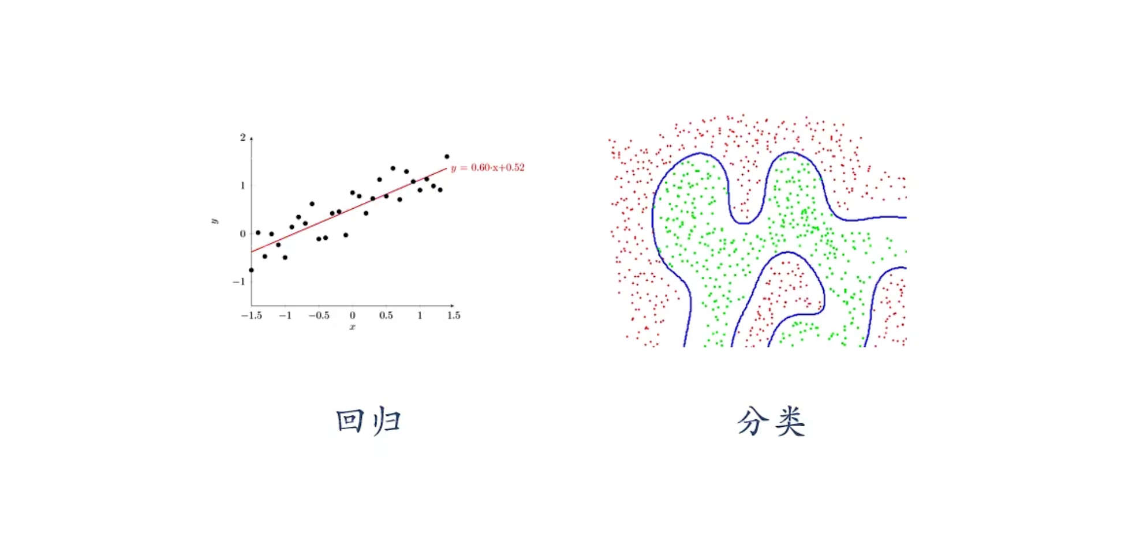
Typical Supervised Learning
Regression
Classification

Slide 4
Chapter 3.1: Logistic Regression

Slide 5
Outline
Classification
Cost function and gradient
Multi-class
Regularization

Slide 6

Classification
Email: Spam / Not Spam?
Online Transactions: Fraudulent (Yes / No)?
Tumor: Malignant / Benign ?
0: “Negative Class” (e.g., benign tumor)
1: “Positive Class” (e.g., malignant tumor)
$$y∈\{0,1\}$$

Slide 7

Classification
(Yes) 1
Malignant ?
(No) 0
Tumor Size
Tumor Size
Threshold classifier output $h_{θ}\left(x\right)$ at 0.5:
If $h_{θ}\left(x\right)≥0.5$, predict “$y = 1$”
If $h_{θ}\left(x\right)<0.5$, predict “$y = 0$”

Slide 8
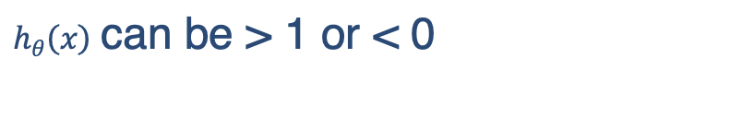
Classification
Classification: $y = 0$ or $1$
$h_{θ}\left(x\right)$ can be > 1 or < 0
Logistic Regression: ${0≤h}_{θ}\left(x\right)≤1$

Slide 9
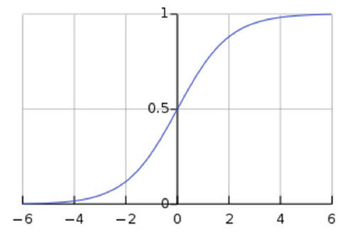
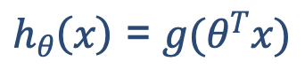
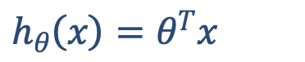

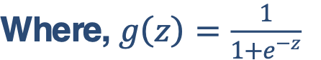
Hypothesis Representation
Logistic Regression Model
Want ${0≤h}_{θ}\left(x\right)≤1$
$h_{θ}\left(x\right)=θ^{T}x$
$h_{θ}\left(x\right)$ = $g(θ^{T}x)$
Where, $g\left(z\right)=\frac{1}{1+e^{−z}}$
Sigmoid function
Logistic function

Slide 10


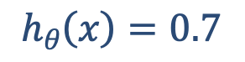
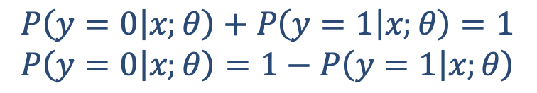
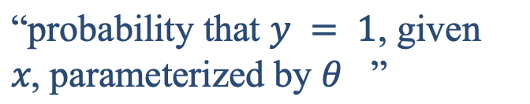
Interpretation of Hypothesis Output
$h_{θ}\left(x\right)$= estimated probability that y = 1 on input x
Example: If $x=\left[\begin{aligned}x_{0} \\ x_{1}\end{aligned}\right]=\left[\begin{aligned}1 \\ tumorSize\end{aligned}\right]$
$$h_{θ}\left(x\right)=0.7$$
Tell patient that 70% chance of tumor being malignant
“probability that $y = 1$, given $x$, parameterized by $θ$ ”
$$h_{θ}\left(x\right)=P(y=1|x;θ)$$
$$P\left(y=0 | x;θ\right)+P\left(y=1 | x;θ\right)=1$$
$$P\left(y=0 | x;θ\right)=1−P\left(y=1 | x;θ\right)$$

Slide 11
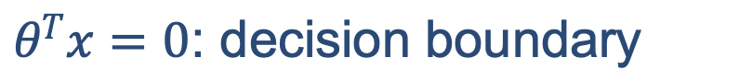
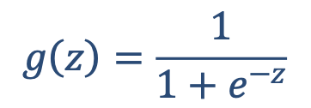
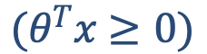
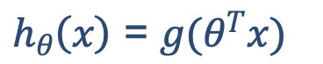
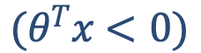
Decision boundary
Logistic regression
$h_{θ}\left(x\right)$ = $g(θ^{T}x)$
$$g\left(z\right)=\frac{1}{1+e^{−z}}$$
Suppose predict "$y=1"$ if $h_{θ}\left(x\right)≥0.5$
$$(θ^{T}x≥0)$$
predict $"y=0"$ if $h_{θ}\left(x\right)<0.5$
$$(θ^{T}x<0)$$
$θ^{T}x=0$: decision boundary

Slide 12
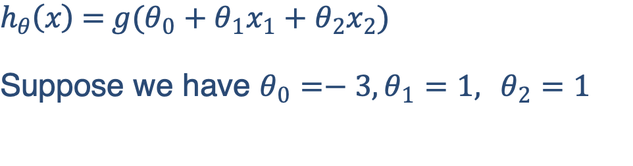
Decision boundary
x₂
$$h_{θ}\left(x\right) \text{= }g(θ_{0}+θ_{1}x_{1}+θ_{2}x_{2})$$
Suppose we have $θ_{0}=−3,θ_{1}=1, θ_{2}=1$
3
2
1
1
2
3
x₁
Predict “$y=1$” if $−3+x_{1}+x_{2}≥0$
Predict “$y=0$” otherwise

Slide 13
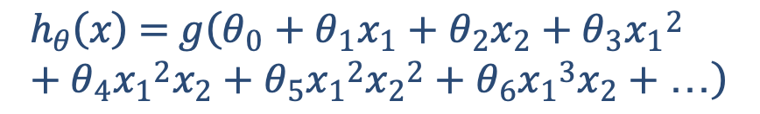
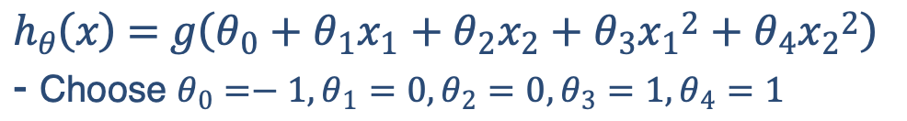
Non-linear decision boundaries
x₂
1
$$h_{θ}\left(x\right) \text{= }g\left(θ_{0}+θ_{1}x_{1}+θ_{2}x_{2}+θ_{3}{x_{1}}^{2}+θ_{4}{x_{2}}^{2}\right)$$
- Choose $θ_{0}=−1,θ_{1}=0,θ_{2}=0,θ_{3}=1,θ_{4}=1$
1
x₁
-1
-1
Predict “𝑦=1“ if $−1+{x_{1}}^{2}+{x_{2}}^{2}≥0$
Predict “𝑦=0” otherwise
x₂
$$h_{θ}\left(x\right) \text{= }g\left(θ_{0}+θ_{1}x_{1}+θ_{2}x_{2}+θ_{3}{x_{1}}^{2}+θ_{4}{x_{1}}^{2}x_{2}+θ_{5}{x_{1}}^{2}{x_{2}}^{2}+θ_{6}{x_{1}}^{3}x_{2}+…\right)$$
x₁

Slide 14
Outline
Classification
Cost function and gradient
Multi-class
Regularization

Slide 15
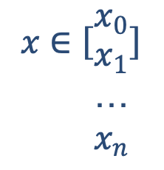
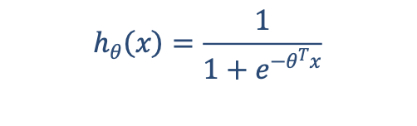
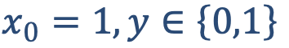
Cost function
Training set:$\left\{\left(x^{\left(1\right)}\text{, }y^{\left(1\right)}\right),\left(x^{\left(2\right)}\text{, }y^{\left(2\right)}\right),…,\left(x^{\left(m\right)}\text{, }y^{\left(m\right)}\right)\right\}$
$$x∈\left[{x_{0} \atop \begin{aligned}x_{1} \\ … \\ x_{n}\end{aligned}}\right]$$
m examples
$$x_{0}=1,y∈\left\{0,1\right\}$$
$$h_{θ}\left(x\right)=\frac{1}{1+e^{−θ^{T}x}}$$
How to choose parameters $θ$?

Slide 16


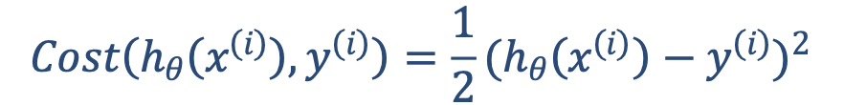
Cost function
Linear regression:$J\left(θ\right)=\frac{1}{m}\sum_{i=1}^{m}{\frac{1}{2}{(h_{θ}\left(x^{\left(i\right)}\right)−y^{\left(i\right)})}^{2}}$
$$Cost\left(h_{θ}\left(x^{\left(i\right)}\right),y^{\left(i\right)}\right)=\frac{1}{2}{(h_{θ}\left(x^{\left(i\right)}\right)−y^{\left(i\right)})}^{2}$$
“non-convex”
“convex”

Slide 17
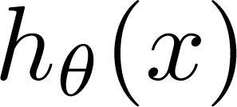

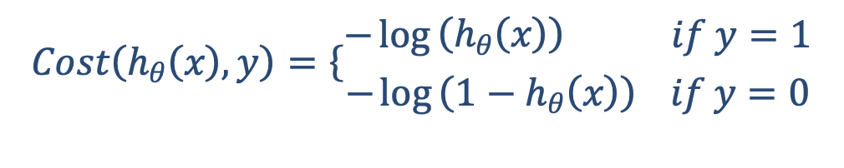

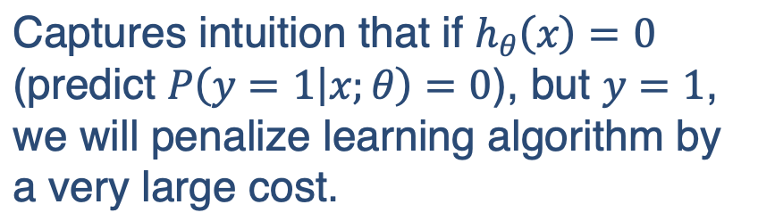
Logistic regression cost function
$$Cost\left(h_{θ}\left(x\right),y\right)=\left\{\begin{aligned}−\log\left(h_{θ}\left(x\right)\right) if y=1 \\ −\log\left(1−h_{θ}\left(x\right)\right) if y=0\end{aligned}\right.$$
If y = 1
$Cost=0$ if $y=1,h_{θ}\left(x\right)=1$
But, as $h_{θ}\left(x\right)→0, Cost→∞$
Captures intuition that if $h_{θ}\left(x\right)=0$ (predict $P\left(y=1 | x;θ\right)=0$), but $y=1$, we will penalize learning algorithm by a very large cost.
0
1

Slide 18
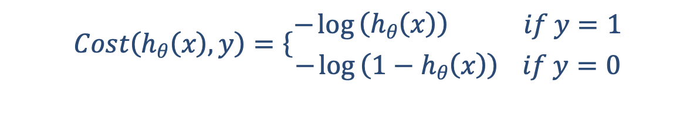
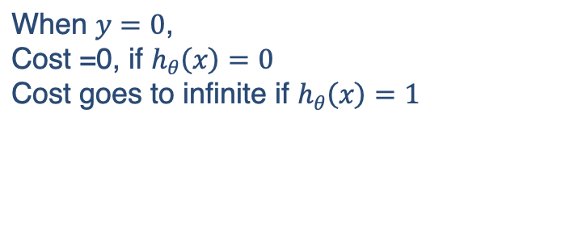
Logistic regression cost function
$$Cost\left(h_{θ}\left(x\right),y\right)=\left\{\begin{aligned}−\log\left(h_{θ}\left(x\right)\right) if y=1 \\ −\log\left(1−h_{θ}\left(x\right)\right) if y=0\end{aligned}\right.$$
If y =0
When $y=0$,
Cost =0, if $h_{θ}\left(x\right)=0$
Cost goes to infinite if $h_{θ}\left(x\right)=1$
0
1

Slide 19
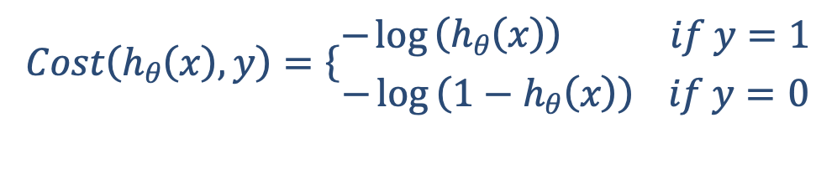
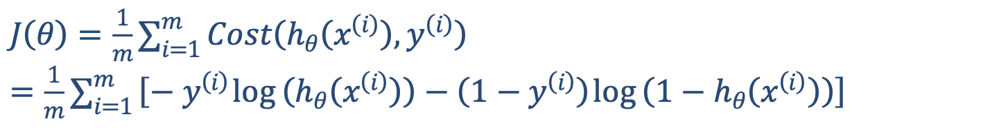
Logistic regression cost function
Simplification:
$J\left(θ\right)=\frac{1}{m}\sum_{i=1}^{m}{Cost\left(h_{θ}\left(x^{\left(i\right)}\right),y^{\left(i\right)}\right) }$
$$Cost\left(h_{θ}\left(x\right),y\right)=\left\{\begin{aligned}−\log\left(h_{θ}\left(x\right)\right) if y=1 \\ −\log\left(1−h_{θ}\left(x\right)\right) if y=0\end{aligned}\right.$$
Note: $y=0$ or $1$ always
$J\left(θ\right)=\frac{1}{m}\sum_{i=1}^{m}{Cost\left(h_{θ}\left(x^{\left(i\right)}\right),y^{\left(i\right)}\right) }$
$=\frac{1}{m}\sum_{i=1}^{m}{\left[−y^{\left(i\right)}\log\left(h_{θ}\left(x^{\left(i\right)}\right)\right)−\left(1−y^{\left(i\right)}\right)\log\left(1−h_{θ}\left(x^{\left(i\right)}\right)\right)\right]}$

Slide 20

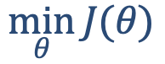
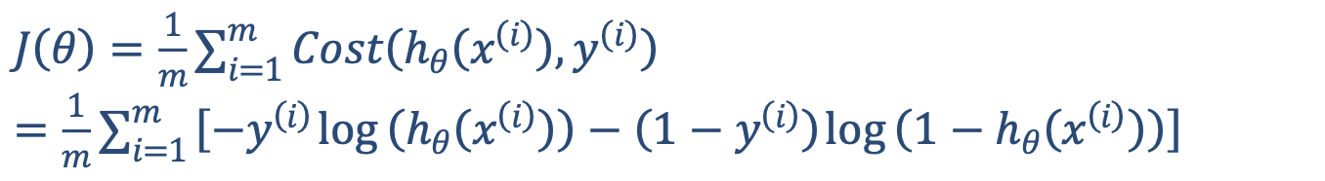
Logistic regression cost function
$J\left(θ\right)=\frac{1}{m}\sum_{i=1}^{m}{Cost\left(h_{θ}\left(x^{\left(i\right)}\right),y^{\left(i\right)}\right) }$
$=\frac{1}{m}\sum_{i=1}^{m}{\left[{−y}^{\left(i\right)}\log\left(h_{θ}\left(x^{\left(i\right)}\right)\right)−\left(1−y^{\left(i\right)}\right)\log\left(1−h_{θ}\left(x^{\left(i\right)}\right)\right)\right]}$
To fit parameters $θ$ :
$$\min_{θ}{J(θ)}$$
To make a prediction given new $x$ :
Output $h_{θ}\left(x\right)=\frac{1}{1+e^{−θ^{T}x}}$

Slide 21



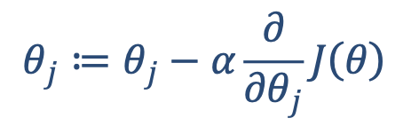
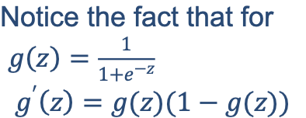
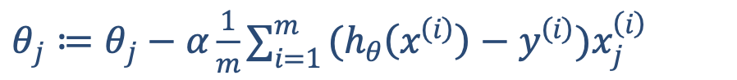
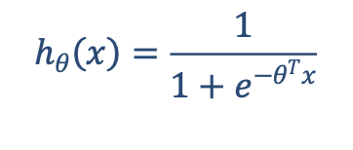
Gradient Descent
$J\left(θ\right)=\frac{1}{m}\sum_{i=1}^{m}{\left[{−y}^{\left(i\right)}\log\left(h_{θ}\left(x^{\left(i\right)}\right)\right)−\left(1−y^{\left(i\right)}\right)\log\left(1−h_{θ}\left(x^{\left(i\right)}\right)\right)\right]}$
Want $\min_{θ}{J(θ)}$:
Repeat
$$θ_{j}≔θ_{j}−α\frac{∂}{∂θ_{j}}J\left(θ\right)$$
Notice the fact that for
$g\left(z\right)=\frac{1}{1+e^{−z}}$
$$g^{′}\left(z\right)=g(z)(1−g(z))$$
(simultaneously update all $θ_{j}$ )
Repeat
$θ_{j}≔θ_{j}−α\frac{1}{m}\sum_{i=1}^{m}{(h_{θ}\left(x^{\left(i\right)}\right)−y^{\left(i\right)})x_{j}^{\left(i\right)}}$
$$h_{θ}\left(x\right)=\frac{1}{1+e^{−θ^{T}x}}$$
(simultaneously update all $θ_{j}$)
Algorithm looks identical to linear regression!

Slide 22
Outline
Classification
Cost function and gradient
Multi-class
Regularization

Slide 23
Multiclass classification
Email foldering/tagging: Work, Friends, Family, Hobby
Medical diagrams: Not ill, Cold, Flu, Coro-V
Weather: Sunny, Cloudy, Rain, Snow

Slide 24
Multiclass classification
Binary classification:
Multi-class classification:
x₂
x₂
x₁
x₁

Slide 25
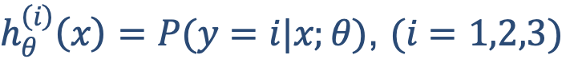
Multiclass classification
x₂
One-vs-all (one-vs-rest):
x₁
x₂
x₂
x₁
x₁
Class 1:
Class 2:
Class 3:
x₂
x₁
$h_{θ}^{\left(i\right)}\left(x\right)=P(y=i|x;θ)$, $(i=1,2,3)$

Slide 26


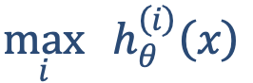
Multiclass classification
Train a logistic regression classifier $h_{θ}^{\left(i\right)}\left(x\right)$ for each class $i$ to predict the probability that $y=i$.
On a new input $x$, to make a prediction, pick the class $i$ that maximizes $h_{θ}^{\left(i\right)}\left(x\right)$
$$\max_{i}{h_{θ}^{\left(i\right)}\left(x\right)}$$

Slide 27
Outline
Classification
Cost function and gradient
Multi-class
Regularization

Slide 28
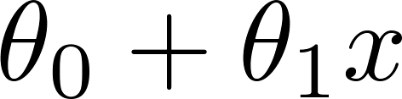
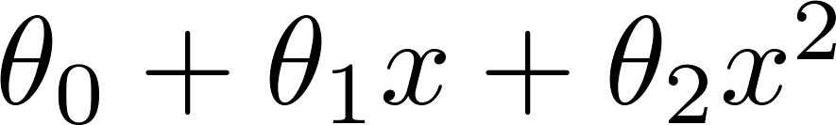
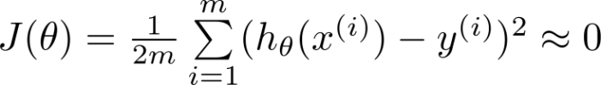
Regularization-The problem of overfitting
Example: Linear regression (housing prices)
Price
Price
Price
Size
Size
Size
Overfitting: If we have too many features, the learned hypothesis may fit the training set very well ( ), but fail to generalize to new examples (predict prices on new examples).

Slide 29
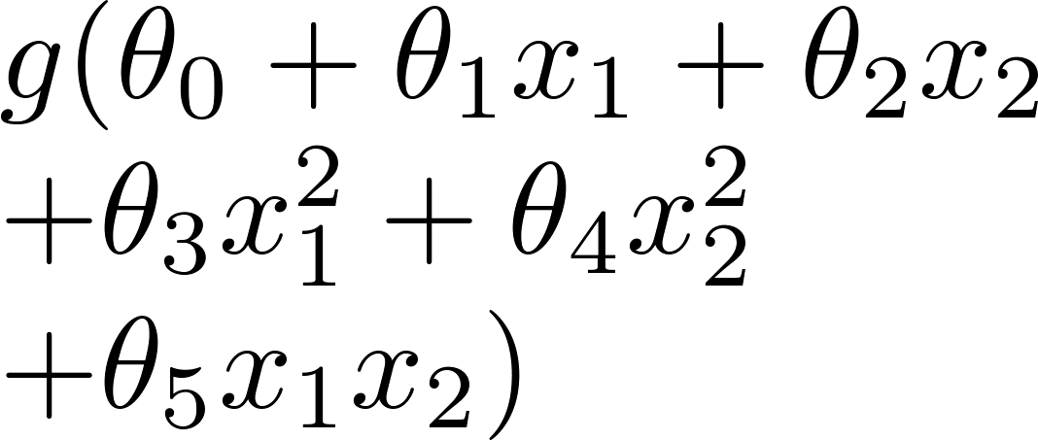
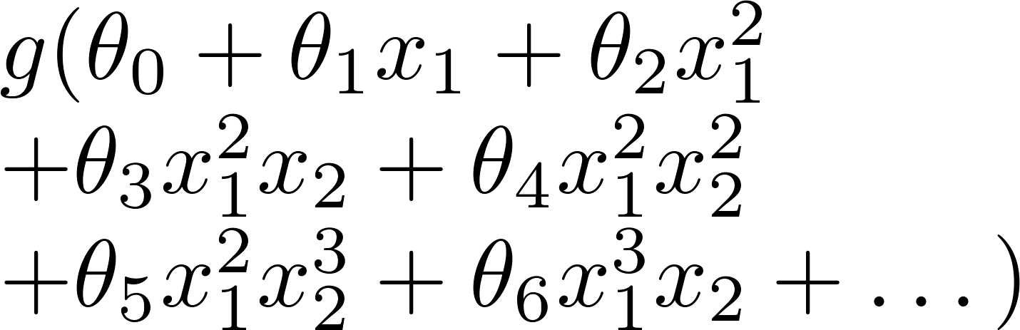
Example: Logistic regression
x₂
x₂
x₂
x₁
x₁
x₁
( = sigmoid function)

Slide 30


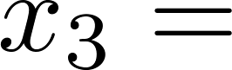
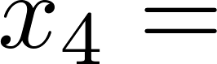
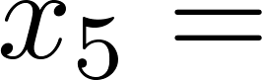
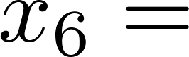
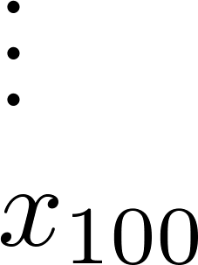
Addressing overfitting
size of house
no. of bedrooms
no. of floors
Price
age of house
average income in neighborhood
Size
kitchen size

Slide 31
Addressing overfitting
Options:
Reduce number of features.
Manually select which features to keep.
Model selection algorithm.
Regularization.
Keep all the features, but reduce magnitude/values of parameters.
Works well when we have a lot of features, each of which contributes a bit to predicting.

Slide 32
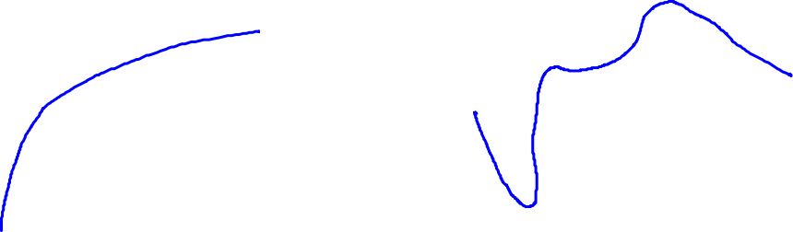
Intuition
Price
Price
Size of house
Size of house
$\min_{θ}{\frac{1}{2m}\sum_{i=1}^{m}{{\left(h_{θ}\left(x^{\left(i\right)}\right)−y^{(i)}\right)}^{2}+1000θ_{3}^{2}+1000θ_{4}^{2} }}$

Slide 33
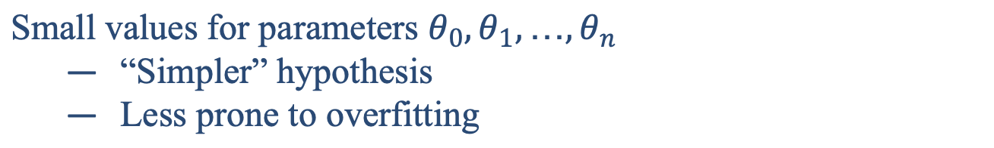

Regularization
Small values for parameters $θ_{0},θ_{1},…,θ_{n}$
“Simpler” hypothesis
Less prone to overfitting
Housing:
Features: $x_{0},x_{1},…,x_{100}$
Parameters:${ θ}_{0},θ_{1},…,θ_{100}$
$\min_{θ}{\frac{1}{2m}\left[\sum_{i=1}^{m}{{\left(h_{θ}\left(x^{\left(i\right)}\right)−y^{(i)}\right)}^{2}+λ\sum_{j=1}^{n}{θ_{j}^{2}} }\right]}$

Slide 34
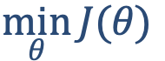
Regularization
$\min_{θ}{\frac{1}{2m}\left[\sum_{i=1}^{m}{{\left(h_{θ}\left(x^{\left(i\right)}\right)−y^{(i)}\right)}^{2}+λ\sum_{j=1}^{n}{θ_{j}^{2}} }\right]}$
$$\min_{θ}{J(θ)}$$
The two parts in the cost function make a balance between bias and variance, so that the model doesn’t go underfitting or overfitting too much
Price
Size of house

Slide 35
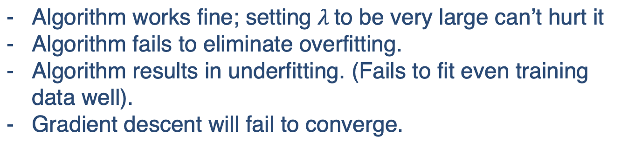

Regularization
In regularized linear regression, we choose $θ$ to minimize
$\min_{θ}{\frac{1}{2m}\left[\sum_{i=1}^{m}{{\left(h_{θ}\left(x^{\left(i\right)}\right)−y^{(i)}\right)}^{2}+λ\sum_{j=1}^{n}{θ_{j}^{2}} }\right]}$
What if $λ$ is set to an extremely large value (perhaps for too large for our problem, say $λ={10}^{10}$)?
Algorithm works fine; setting $λ$to be very large can’t hurt it
Algorithm fails to eliminate overfitting.
Algorithm results in underfitting. (Fails to fit even training data well).
Gradient descent will fail to converge.

Slide 36

Regularization
In regularized linear regression, we choose $θ$ to minimize
$\min_{θ}{\frac{1}{2m}\left[\sum_{i=1}^{m}{{\left(h_{θ}\left(x^{\left(i\right)}\right)−y^{(i)}\right)}^{2}+λ\sum_{j=1}^{n}{θ_{j}^{2}} }\right]}$
What if $λ$is set to an extremely large value (perhaps for too large for our problem, say $λ={10}^{10}$)?
Price
underfitting
Size of house
All theta are penalized to almost 0

Slide 37




Regularization: linear regression
$\min_{θ}{\frac{1}{2m}\left[\sum_{i=1}^{m}{{\left(h_{θ}\left(x^{\left(i\right)}\right)−y^{(i)}\right)}^{2}+λ\sum_{j=1}^{n}{θ_{j}^{2}} }\right]}$
$$\min_{θ}{J(θ)}$$
Gradient descent
Repeat
$θ_{0}≔θ_{0}−α\frac{1}{m}\sum_{i=1}^{m}{(h_{θ}\left(x^{\left(i\right)}\right)−y^{\left(i\right)})x_{0}^{\left(i\right)}}$
$θ_{j}≔θ_{j}−α\frac{1}{m}\sum_{i=1}^{m}{\left(h_{θ}\left(x^{\left(i\right)}\right)−y^{\left(i\right)}\right)x_{j}^{\left(i\right)}}−α\frac{λ}{m}θ_{j}$
$$(j=1,2,…,n)$$
$θ_{j}≔θ_{j}\left(1−α\frac{λ}{m}\right)−α\frac{1}{m}\sum_{i=1}^{m}{\left(h_{θ}\left(x^{\left(i\right)}\right)−y^{\left(i\right)}\right)x_{j}^{\left(i\right)}}$

Slide 38


Regularization: logistic regression
x₂
x₁
Cost function:
$J\left(θ\right)=\frac{1}{m}\sum_{i=1}^{m}{\left[{−y}^{\left(i\right)}\log\left(h_{θ}\left(x^{\left(i\right)}\right)\right)−\left(1−y^{\left(i\right)}\right)\log\left(1−h_{θ}\left(x^{\left(i\right)}\right)\right)\right]+\frac{λ}{2m}\sum_{j=1}^{n}{θ_{j}^{2}}}$

Slide 39

Regularization: logistic regression
Gradient descent
Repeat
$θ_{0}≔θ_{0}−α\frac{1}{m}\sum_{i=1}^{m}{(h_{θ}\left(x^{\left(i\right)}\right)−y^{\left(i\right)})x_{0}^{\left(i\right)}}$
$θ_{j}≔θ_{j}−α\frac{1}{m}\sum_{i=1}^{m}{\left(h_{θ}\left(x^{\left(i\right)}\right)−y^{\left(i\right)}\right)x_{j}^{\left(i\right)}}−α\frac{λ}{m}θ_{j}$
$$(j=1,2,…,n)$$
The above gradient formula looks exactly like what we have in linear regression, the only difference is the form of $h_{θ}\left(x^{\left(i\right)}\right)$.

Slide 40
Chapter 3.2: Support Vector Machine

Slide 41
Outline
Support vector machine model
Constrained optimization
Soft margin
Kernel methods

Slide 42
Linear Separators
Binary classification can be viewed as the task of separating classes in feature space:
w^{T}x + b = 0
w^{T}x + b > 0
w^{T}x + b < 0
f(x) = sign(w^{T}x + b)

Slide 43
Which of the linear separators is optimal?

Slide 44

Classification Margin
Distance from example x to the separator is $d=\frac{|w^{T}x+b|}{\left\|w\right\|}$.
Examples closest to the hyperplane are support vectors.
Margin $γ$ of the separator is the distance between support vectors.
r

Slide 45
Maximum Margin Classification
Maximizing the margin is good according to intuition and probably approximately correct (PAC) theory.
Implies that only support vectors matter; other training examples are ignorable.

Slide 46
Goal of SVM
The goal is to find the decision boundary with maximum margin
SVM also called large margin classifier
This line (hyperplane) not only separates the two classes but also stays as far away from the closest training instances as possible
optimal hyperplane
maximum margin

Slide 47

Linear SVM Mathematically
Training set $\left\{\left(x_{1},y_{1}\right),\left(x_{2},y_{2}\right),…, \left(x_{m},y_{m}\right)\right\}$
$x_{i}∈ℝ^{n}$: input features
$y_{i}∈\{±1\}$: input label
Assume that the problem is linearly separable
there exists a linear surface to separate the two classes
2-D: line; 3-D: plane; ... ; n-D: hyperplane ($w^{T}x+b=0$)
$w=(w_{1},w_{2},…,w_{n})$: weight vector
$b$: scalar
Find a hyperplane that perfectly separates the two classes

Slide 48

Distance of a Point to Hyperplane
A hyperplane is defined through $w$ and $b$ as a set of points such that $ℋ=\left\{x|w^{T}x+b=0\right\}$
$w=(w_{1},w_{2},…,w_{n})$: weight vector
$b$: scalar
What is the distance ($d$) of a point $x$ to hyperplane $ℋ$?
$d=\frac{|w^{T}x+b|}{\left\|w\right\|}$, $\left\|w\right\|$ is the norm/length of the vector
Margin of $ℋ$ with respect to $D$ (training set):
$γ\left(w,b\right)=\min_{x∈D}{\frac{2|w^{T}x+b|}{\left\|w\right\|}}$
The margin and hyperplane are scale invariant:
$γ\left(βw,βb\right)=γ\left(w,b\right), ∀β≠0$

Slide 49

Optimization Problem
We can formulate our search for the maximum margin separating hyperplane as a constrained optimization problem
The objective is to maximize the margin under the constraints that all data points must lie on the correct side of they hyperplane:
$${\max_{w,b}{γ(w,b)} \atop s.t. y_{i}\left(w^{T}x_{i}+b\right)≥0, ∀i}$$

Slide 50

Optimization Problem
Because the hyperplane is scale invariant, we can fix the scale of $w,b$ anyway we want. Let’s choose it such that
$$\min_{x∈D}\left|w^{T}x+b\right|=1$$
Then our objective becomes:
$$\max_{w,b}{γ(w,b)}=\max_{w,b}\left\{\min_{x∈D}{\frac{2|w^{T}x+b|}{\left\|w\right\|}}\right\}=\max_{w,b}\frac{2}{\left\|w\right\|}$$
The constraints are:
$$y_{i}\left(w^{T}x_{i}+b\right)≥0, ∀i$$
$$\min_{x∈D}\left|w^{T}x+b\right|=1$$

Slide 51

SVM model
Consider the constraints:
$$y_{i}\left(w^{T}x_{i}+b\right)≥0, ∀i$$
$$\min_{xεD}\left|w^{T}x+b\right|=1$$
$w^{T}x_{i}+b$ $\left\{\begin{aligned}≥0 ∧ ≥ 1 if y_{i}=1 \\ ≤0 ∧ ≤−1 if y_{i}=−1\end{aligned}\right.$
Therefore, the two constraints can be represented by:
$$y_{i}\left(w^{T}x_{i}+b\right)≥1, ∀i$$
The optimization problem is equivalent to a simpler formulation (SVM model):
$${\min_{w,b}{\frac{1}{2}{\left\|w\right\|}^{2}} \atop s.t. y_{i}\left(w^{T}x_{i}+b\right)≥1, ∀i}$$
This can be solved with quadratic programming algorithm using Lagrange multipliers.

Slide 52

Lagrange Multiplier (Optional)
Consider a problem of the following form:
$${\min_{w}{f(w)} \atop s.t. { h}_{i}\left(w\right)=0, i=1,…,l}$$
Use the Lagrange multiplier method to solve the problem
Define the Lagrangian to be $ℒ\left(w,β\right)=f\left(w\right)+\sum_{i=1}^{l}{β_{i}}{ h}_{i}\left(w\right)$
$β_{i}$'s are called the Lagrange multipliers
Then solve the problem by set $ℒ$ partial derivative to 0, $\frac{∂ℒ}{∂w}=0$, $\frac{∂ℒ}{∂β_{i}}=0$
Notes:
In mathematical optimization, the method of Lagrange multipliers is a strategy for finding the local maxima and minima of a function subject to equality constraints (i.e., subject to the condition that one or more equations have to be satisfied exactly by the chosen values of the variables).

Slide 53

Lagrange Multiplier (Optional)
Find the maximum and minimum values of $f\left(x,y\right)=3x−4y$ subject to the constraint $x^{2}+{3y}^{2}−129=0$.
Lagrangian: $ℒ\left(x,y,β\right)=3x−4y+β\left(x^{2}+{3y}^{2}−129\right)$
Find critical points
$\frac{∂ℒ}{∂x}=3+2βx=0$
$\frac{∂ℒ}{∂y}=−4+6βy=0$
$\frac{∂ℒ}{∂β}=x^{2}+{3y}^{2}−129=0$
$β=±\frac{1}{6}$, two critical points $\left\{x=−9,y=4\right\}$, $\left\{x=9,y=−4\right\}$
Plug these into the function
$f\left(−9,4\right)=−43$ (minimum)
$f\left(9,−4\right)=43$(maximum)
Notes:
In calculus, the extreme value theorem states that if a real-valued function f is continuous on the closed interval [a,b], then f must attain a maximum and a minimum, each at least once.
We can find maximum and minimum values of a function f(x) at its critical points. Critical points of a function are those where its derivative either zero or undefined (i. e. corner of a function).

Slide 54
Duality (Optional)
In optimization theory, duality means that optimization problems may be viewed from either of two perspectives, the primal problem or the dual problem.
The solution to the dual problem provides a lower bound to the solution of the primal (minimization) problem.
If you have a minimization problem, you can also see it as a maximization problem. And when you find the maximum of this problem, it will be a lower bound to the solution of the minimization problem.

Slide 55


Duality (Optional)
Sometimes, solving the dual problem is simpler than solving the primal problem.
Under certain convexity assumptions and suitable constraint qualifications, the primal and dual problems have equal optimal objective values.
Weak duality with duality gap
Strong duality without duality gap

Slide 56

Lagrange Duality (Optional)
Consider a generalized constrained optimization problem which contains inequality as well as equality constraints.:
$${\min_{w}{f(w)} \atop {s.t. { g}_{i}\left(w\right)≤0, i=1,…,k \atop { h}_{i}\left(w\right)=0, i=1,…,l }}$$
Also called primal problem. To solve it, we start by defining the generalized Lagrangian:
$ℒ\left(w,α,β\right)=f\left(w\right)+\sum_{i=1}^{k}{α_{i}}{ g}_{i}\left(w\right)+\sum_{i=1}^{l}{β_{i}}{ h}_{i}\left(w\right)$
Here, the $α_{i}^{′}s$ and $β_{i}^{′}s$ are the Lagrange multipliers or dual variables
objective is augmented with weighted sum of constraint functions
Notes:
Lagrange dual problem is always convex: (ignore the proof) it’s a convex problem
affine function in terms of alpha and beta.
Affine: y = Ax+b
Or A1x1+A2x2+..+b
Dual problem can be –infinite and has a maximum value, so concave.

Slide 57

Lagrange Duality (Optional)
Consider the quantity
$$θ_{𝒫}\left(w\right)=\max_{α,β:α_{i}≥0}{ℒ\left(w,α,β\right)}$$
$𝒫$ stands for “primal”. Let $w$ be given, if $w$ violates any of the primal constraints then $θ_{𝒫}\left(w\right)=∞$; if the constraints are indeed satisfied for a particular value of $w$, then $θ_{𝒫}\left(w\right)=f(w)$.
Hence,
$θ_{𝒫}\left(w\right)=\left\{\begin{aligned}f\left(w\right) \\ ∞\end{aligned}\right.$
if w satisfied the primal constraints
otherwise
Notes:
In mathematical optimization theory, duality means that optimization problems may be viewed from either of two perspectives, the primal problem or the dual problem (the duality principle). The solution to the dual problem provides a lower bound to the solution of the primal (minimization) problem.

Slide 58

Dual Problem (Optional)
Hence, consider the minimization problem
$$\min_{w}{θ_{𝒫}}\left(w\right)=\min_{w}\max_{α,β:α_{i}≥0}{ℒ\left(w,α,β\right)}$$
It is the same as our original, primal problem. Let optimal value of the primal problem be $p^{∗}=\min_{w}{θ_{𝒫}}\left(w\right)$
Now, lets look at a slightly different problem:
$$θ_{D}\left(α,β\right)=\min_{w} ℒ\left(w,α,β\right)$$
New problem is optimizing (maximizing) w.r.t to $α,β$, which are minimized w.r.t. $w$.
Then, we can have the dual optimization problem:
$$\max_{α,β:α_{i}≥0}{θ_{D}}\left(α,β\right)=\max_{α,β:α_{i}≥0}\min_{w}ℒ\left(w,α,β\right)$$
This is exactly the same as our primal problem shown above, except that the order of the "max" and the "min" are now exchanged.
Notes:
Lagrange dual problem is always concave: affine function in terms of alpha and beta.
Affine: y = Ax+b
Or A1x1+A2x2+..+b
Dual problem has maximum: f(w) minimum:

Slide 59

Dual Problem (Optional)
Let $d^{∗}=\max_{α,β:α_{i}≥0}\min_{w}ℒ\left(w,α,β\right)≤\min_{w}\max_{α,β:α_{i}≥0}ℒ\left(w,α,β\right)=p^{∗}$
The solution to the dual problem provides a lower bound to the solution of the primal (minimization) problem
Now, we can solve the dual problem in lieu of the primal problem
Easier for computation
Kernel functions
Under the condition that $f$ and $g_{i}^{′}s$ are convex functions and $h_{i}^{′}s$ are affine. And constraints of $g_{i}$ are strictly feasible
There exists $w^{∗}$, $α^{∗}$, $β^{∗}$, so that $w^{∗}$ is the solution to the primal problem and $α^{∗}$, $β^{∗}$ are solution to the dual problem and $p^{∗}=d^{∗}=ℒ\left(w^{∗},α^{∗},β^{∗}\right)$
Moreover, $w^{∗}$, $α^{∗}$, $β^{∗}$ satisfy the KKT conditions
Notes:
Affine 仿射变换；In geometry, an affine transformation, affine map or an affinity is a function between affine spaces which preserves points, straight lines and planes.
I.e., there exists ai , bi , so that hi(w) = a T i w + bi . “Affine” means the same thing as linear, except that we also allow the extra intercept term bi
Convex function: A set in Euclidean space R^d is convex set if it contains all the line segments connecting any pair of its points

Slide 60


Karush-Kuhn-Tucker Conditions (Optional)
KKT conditions are as follows:
Consider equation (3), it implies that if${ α}_{i}^{∗}>0$, then $g_{i}\left(w^{∗}\right)=0$. (Key for finding SVM support vectors!)
$\frac{∂}{∂_{w_{j}}}ℒ\left(w^{∗},α^{∗},β^{∗}\right)=0$, $∀j$ $\left(1\right)$
$\frac{∂}{∂_{β_{i}}}ℒ\left(w^{∗},α^{∗},β^{∗}\right)=0,$ $∀i$ $\left(2\right)$ ($h_{i}\left(w^{∗}\right)=0$)
$α_{i}^{∗}g_{i}\left(w^{∗}\right)=0$, $∀i$ $\left(3\right)$
$g_{i}\left(w^{∗}\right)≤0, ∀i$ $\left(4\right)$
$α_{i}^{∗}≥0$, $∀i$ $\left(5\right)$
Notes:
Primal feasibility , exist w*， then g(w*)<=0
Dual feasibilty, alpha*>=0
Completeness slackness (互补松弛条件) $α_{i}^{∗}g_{i}\left(w^{∗}\right)=0$
Staionary: derivative must be zero, w* , $α^{∗}$, $β^{∗}$ is the minimum point, derivative = 0

Slide 61

Optimal Margin Classifier (Optional)
SVM optimization problem:
$${\min_{w,b}{\frac{1}{2}{\left\|w\right\|}^{2}} \atop s.t. y_{i}\left(w^{T}x_{i}+b\right)≥1, i=1,2,…,m }$$
We can write the constraints as
$$g_{i}\left(w\right)=1−y_{i}\left(w^{T}x_{i}+b\right)≤0$$
When we construct the Lagrangian for our optimization problem we have:
$ℒ\left(w,b,α\right)=\frac{1}{2}{\left\|w\right\|}^{2}+\sum_{i=1}^{m}{α_{i}\left[1−y_{i}\left(w^{T}x_{i}+b\right)\right]}$
Let’s find the dual form of the problem.
First minimize $ℒ\left(w,b,α\right)$with respect to $w$ and $b$ (for fixed $α$), to get $θ_{D}\left(α\right)$.
Notes:
$\frac{1}{2}{\left\|w\right\|}^{2}$ convex function second derivative of x is 1>0 convex
similarly, all linear (and ane) functions are also convex.
$1−y_{i}\left(w^{T}x_{i}+b\right)$ convex，second derivate =0
Affine: there exists ai , bi , so that hi (w ) = aTi w + bi . (linear transformation, allow intercept)

Slide 62

Dual Optimization Problem (Optional)
We’ll do by setting the derivatives of $ℒ$ with respect to $w$ and $b$ to zero:
$$\frac{∂}{∂w}ℒ\left(w,b,α\right)=w−\sum_{i=1}^{m}{α_{i}y_{i}}x_{i}=0$$
$$\frac{∂}{∂b}ℒ\left(w,b,α\right)=\sum_{i=1}^{m}{−α_{i}y_{i}}=0$$
We have: $w=\sum_{i=1}^{m}{α_{i}y_{i}}x_{i}$ and $\sum_{i=1}^{m}{α_{i}y_{i}}=0$, plug back into Lagrangian equation:
$$ℒ\left(w,b,α\right)=\frac{1}{2}{\left\|w\right\|}^{2}+\sum_{i=1}^{m}{α_{i}\left[1−y_{i}\left(w^{T}x_{i}+b\right)\right]}$$
$$=\sum_{i=1}^{m}{α_{i}}−\frac{1}{2}\sum_{i=1}^{m}{\sum_{j=1}^{m}{α_{i}α_{j}y_{i}y_{j}}}{x_{i}}^{T}x_{j}−b\sum_{i=1}^{m}{α_{i}y_{i}}$$
$$=\sum_{i=1}^{m}{α_{i}}−\frac{1}{2}\sum_{i=1}^{m}{\sum_{j=1}^{m}{α_{i}α_{j}y_{i}y_{j}}}{x_{i}}^{T}x_{j}$$
Notes:
Because the objective function is convex, so this w,b gives the minimum value.

Slide 63

Dual Optimization Problem (Optional)
Recall that we got the equation by minimizing $ℒ$ with respect to $w$ and $b$. Together with the constraint, we obtain the dual optimization problem:
$\max_{α}{W\left(α\right)=\sum_{i=1}^{m}{α_{i}}−\frac{1}{2}\sum_{i=1}^{m}{\sum_{j=1}^{m}{α_{i}α_{j}y_{i}y_{j}}}{x_{i}}^{T}x_{j}}$
$$s.t. α_{i}≥0, i=1,2,…,m$$
$\sum_{i=1}^{m}{α_{i}y_{i}}=0$
You can verify that the conditions required for $p^{∗}=d^{∗}$ and KKT conditions are satisfied. Therefore, we can solve the dual problem, which is a maximization with parameters $α_{i}^{′}s$.

Slide 64

Dual Optimization Problem (Optional)
Solve the problem with quadratic programming algorithm
Or use SMO (sequential minimal optimization) algorithm to efficiently solve the dual problem.
SMO simply does the following:
Repeat till convergence{
Select some pair $α_{i}$ and $α_{j}$ to update next
Re-optimize $W(α)$ w.r.t $α_{i}$ and $α_{j}$, while holding all the other $α_{k}^{′}s$ fixed
}
Notes:
quadratic programming algorithm
To test for convergence of this algorithm, we can check whether the KKT
conditions (Equations 14-16) are satised to within some tol. Here, tol is
the convergence tolerance parameter, and is typically set to around 0.01 to
0.001.

Slide 65

Support Vectors (Optional)
After we find the $α_{i}^{∗}$, based on the KKT condition, $α_{i}^{∗}g_{i}\left(w^{∗}\right)=0$, the data with $α_{i}^{∗}>0$ are support vectors.
For a solution $α^{∗}={(α_{1}^{∗},α_{2}^{∗},…,α_{m}^{∗})}^{T}$ for the dual problem, if exist $α_{j}^{∗}$ that $α_{j}^{∗}>0$, then the solution for primal problem
$w^{∗}=\sum_{i=1}^{m}{α_{i}^{∗}y_{i}}x_{i}$
$b^{∗}=y_{j}−\sum_{i=1}^{m}{α_{i}^{∗}y_{i}}{x_{i}}^{T}x_{j}$ (why?)
Notes:
y_j*$（w^{T}x_{j}+b$）=1

Slide 66
Chapter 3.3: Support Vector Machine II

Slide 67
Outline
Support vector machine model
Constrained optimization
Soft margin
Kernel methods

Slide 68

Non-linearly separable case
What if training data not linearly separable due to noise or outliers?
Constraint
$y_{i}\left(w^{T}x_{i}+b\right)≥1$ is violated on the outlier/noise

Slide 69
Linearly separable with small margin
Suppose we add an outlier which results in a classifier with a much smaller margin.

Slide 70

Soft Margin
To make the SVM model work for non-linearly separable datasets as well as be less sensitive to outliers
allow error for some samples
Allow some sample violated the constraint:
$y_{i}\left(w^{T}x_{i}+b\right)−1<0$
soft margin, not hard margin
Target: find a hyperplane that
maximize margin
minimize number of errors

Slide 71

Soft Margin
Introduce positive slack variables $ξ_{i}$, constraints:
$\left\{\begin{aligned}w^{T}x_{i}+b ≥1−ξ_{i} y_{i}=1 \\ w^{T}x_{i}+b ≤−\left(1−ξ_{i}\right) y_{i}=−1 \\ ξ_{i}≥0 ∀i\end{aligned}\right.$
New constraints:
$y_{i}\left(w^{T}x_{i}+b\right)≥1−ξ_{i}$
Penalize $ξ_{i}$ in the objective function
for an error to occur, the corresponding $ξ_{i}$ must exceed unity

Slide 72

Optimization problem with soft margin
The optimization problem using soft margin:
$${\min_{w,b}{\frac{1}{2}{\left\|w\right\|}^{2}} \text{+} C\sum_{i}{ξ_{i}} \atop \begin{aligned}s.t. y_{i}\left(w^{T}x_{i}+b\right)≥1−ξ_{i}, i=1,2,…,m \\ ξ_{i}≥0, i=1,2,…,m\end{aligned}}$$
Examples are now permitted to have margin less than 1 and if an example whose margin is $1−ξ_{i}$, we would pay a cost of the objective function being increased by $Cξ_{i}$
Hinge loss: $l_{hinge}\left(z\right)=max⁡(0,1−z)$
Another view of SVM:
$\min_{w,b}{\frac{1}{2}{\left\|w\right\|}^{2}}\text{ +} C\sum_{i}{max⁡(0,1−y_{i}\left(w^{T}x_{i}+b\right))}$
Notes:
Another view of SVM: minimize hinge(1-y_i(wx+b)) + lamda ||w||2
Hinge loss l_h(z) = { z for z>0; 0 for z<0

Slide 73

Optimization problem with soft margin
The parameter $C$ controls the relative weighting between the twin goals of making
the ${\left\|w\right\|}^{2}$ small
ensuring that most examples have margin greater than 1
For large C value: the optimization will choose a smaller-margin hyperplane if that hyperplane does a better job of getting all the training points classified correctly.
For small C value: the optimizer look for a larger-margin separating hyperplane, even if that hyperplane misclassifies more points.
Notes:
Another view of SVM: minimize hinge(1-y_i(wx+b)) + lamda ||w||2
Hinge loss l_h(z) = { z for z>0; 0 for z<0

Slide 74

Optimization problem with soft margin (optional)
Similarly, it is a constrained (convex) quadratic optimization problem. We construct the Lagrangian for this problem:
$ℒ\left(w,b,ξ,α,μ\right)=\frac{1}{2}{\left\|w\right\|}^{2}+C\sum_{i=1}^{m}{ξ_{i}}+$
$\sum_{i=1}^{m}{α_{i}\left[1−ξ_{i}−y_{i}\left(w^{T}x_{i}+b\right)\right]}−\sum_{i=1}^{m}{μ_{i}}ξ_{i}$
where $α_{i}≥0,$ $μ_{i}≥0$ are lagrange multipliers
Find the dual problem do by setting the derivatives of $ℒ$ with respect to $w,b$and $ξ$ to zero:
$\frac{∂}{∂w}ℒ\left(w,b,ξ,α,μ\right)=w−\sum_{i=1}^{m}{α_{i}y_{i}}x_{i}=0$
$\frac{∂}{∂b}ℒ\left(w,b,ξ,α,μ\right)=\sum_{i=1}^{m}{−α_{i}y_{i}}=0$
$\frac{∂}{∂ξ_{i}}ℒ\left(w,b,ξ,α,μ\right)=C−α_{i}−μ_{i}=0$

Slide 75

Optimization problem with soft margin (optional)
Dual problem:
$\max_{α}{W\left(α\right)=\sum_{i=1}^{m}{α_{i}}−\frac{1}{2}\sum_{i=1}^{m}{\sum_{j=1}^{m}{α_{i}α_{j}y_{i}y_{j}}}{x_{i}}^{T}x_{j}}$
$$s.t. C{≥α}_{i}≥0, i=1,2,…,m$$
$\sum_{i=1}^{m}{α_{i}y_{i}}=0$
There exists $w^{∗}$,$b^{∗},ξ^{∗},α^{∗}$, $μ^{∗}$, so that $w^{∗}$,$b^{∗},ξ^{∗}$ is the solution to the primal problem and $α^{∗}$, $μ^{∗}$ are solution to the dual problem and $p^{∗}=d^{∗}=ℒ\left(w^{∗}\text{,}b^{∗},ξ^{∗},α^{∗}\text{, }μ^{∗}\right)$
Moreover, $w^{∗}$,$b^{∗},ξ^{∗},α^{∗}$, $μ^{∗}$ satisfy the KKT conditions
Notes:
Completeness slackness (互补松弛条件) $α_{i}^{∗}(1−ξ_{i}−y_{i}\left(w^{T}x_{i}+b\right))=0$
Primal feasibility
Dual feasibility
Completeness slackness

Slide 76

Optimization problem with soft margin (optional)
Similar with hard margin svm model, besides the partial derivative of $w^{∗}$,$b^{∗},ξ^{∗}$be zero, the KKT conditions are :
$1−ξ_{i}^{∗}−y_{i}\left({w^{∗}}^{T}x_{i}+b^{∗}\right)≤0$, $ξ_{i}^{∗}≥0$ , $∀i$ $\left(1\right)$
$α_{i}^{∗}≥0$, $μ_{i}^{∗}≥0$, $∀i$ $\left(2\right)$
$α_{i}^{∗}(1−ξ_{i}−y_{i}\left({w^{∗}}^{T}x_{i}+b^{∗}\right))=0$, $∀i$ $\left(3\right)$
$$μ_{i}^{∗}ξ_{i}^{∗}=0,∀i \left(4\right)$$
Notes:
Completeness slackness (互补松弛条件) $α_{i}^{∗}(1−ξ_{i}−y_{i}\left(w^{T}x_{i}+b\right))=0$, $μ_{i}^{∗}ξ_{i}^{∗}$=0
Primal feasibility
Dual feasibility

Slide 77

Soft Margin SVM (optional)
For any sample $\left(x_{i},y_{i}\right)$
$α_{i}^{∗}=0$, $μ_{i}=C$, therefore $ξ_{i}=0$ , sample lies beyond the margin.
$0{<α}_{i}^{∗}<C$, $μ_{i}>0$, therefore $ξ_{i}=0$ and $1−ξ_{i}−y_{i}\left(w^{T}x_{i}+b\right)=0$ sample lies on the maximum margin (support vectors)
$α_{i}^{∗}=C$, $μ_{i}=0,$ if $ξ_{i}≤1$, sample lies inside the maximum margin; $ξ_{i}>1$, misclassified (error)
For a solution $α^{∗}={(α_{1}^{∗},α_{2}^{∗},…,α_{m}^{∗})}^{T}$ for the dual problem, if exist $α_{j}^{∗}$ that $0{<α}_{j}^{∗}<C$, then the solution for primal problem
$w^{∗}=\sum_{i=1}^{m}{α_{i}^{∗}y_{i}}x_{i}$
$b^{∗}=y_{j}−\sum_{i=1}^{m}{α_{i}^{∗}y_{i}}{x_{i}}^{T}x_{j}$

Slide 78







Soft Margin SVM
What are the values or range of $ξ_{i}$ for the data samples in the given example?
$$x_{5}$$
$$x_{6}$$
$$x_{1}$$
$$x_{4}$$
$$x_{3}$$
$$x_{2}$$
Notes:
Delta: 0,1, (0,1), 0, >1,>1

Slide 79
Nonlinear SVM
What if training data not linearly separable?
Naïve: find non-linear decision surface
Not efficient
Feature transformation: map the original attributes into new feature space and apply linear model in the new space.

Slide 80


Feature Mapping
Let $φ$ denote the feature mapping
$φ:ℝ^{n}→ℋ,$ $x↦φ\left(x\right)$
where $ℝ^{n}$ is the input space and $ℋ$ is the mapped feature space

Slide 81

Feature Mapping
Example:
$x={\left(x_{1},x_{2}\right)}^{T}$ $→$ $φ\left(x\right)={(x_{1}^{2},\sqrt{2}x_{1}x_{2},x_{2}^{2})}^{T}$
$\left(x_{1},y_{1}\right),…,\left(x_{n},y_{n}\right)→$ $\left(φ(x_{1}),y_{1}\right),…,\left(φ(x_{n}),y_{n}\right)$
$h\left(x\right)=sign\left(w^{T}x+b\right)$ $→sign\left(w^{T}φ\left(x\right)+b\right)$
Apply Linear SVM on mapped feature space, the optimization problem is :
${\min_{w,b}{\frac{1}{2}{\left\|w\right\|}^{2}} \atop s.t. y_{i}\left(w^{T}{φ(x}_{i})+b\right)≥1, i=1,2,…,m }$

Slide 82

Feature Mapping
The dual problem can be written entirely in terms of the inner products of input features ($x_{i}^{T}x_{j}$), this means that we would replace all those inner products with ${{φ(x}_{i})}^{T}φ(x_{j})$.
Dual problem:
$\max_{α}{ \sum_{i=1}^{m}{α_{i}}−\frac{1}{2}\sum_{i=1}^{m}{\sum_{j=1}^{m}{α_{i}α_{j}y_{i}y_{j}}}{{φ(x}_{i})}^{T}φ(x_{j})}$
$$s.t. α_{i}≥0, i=1,2,…,m$$
$\sum_{i=1}^{m}{α_{i}y_{i}}=0$
After solving the dual problem:
$$h\left(x\right)=sign\left(w^{T}φ(x)+b\right)$$
$=sign\left(\sum_{i=1}^{m}{α_{i}y_{i}}{φ\left(x_{i}\right)}^{T}φ\left(x\right)+b\right)$

Slide 83

Feature Mapping
Problem:
${{φ(x}_{i})}^{T}φ(x_{j})$: inner product of mapped feature vectors, may be expensive to calculate as $φ(x_{i})$ may be high dimensional vectors.
For efficient calculation, define kernel function.
Example:
Given input instance with feature dimension 2 and the following feature mapping function
$x={\left(x_{1},x_{2}\right)}^{T}$ $→$ $φ\left(x\right)={(x_{1}^{2},\sqrt{2}x_{1}x_{2},x_{2}^{2})}^{T}$
${φ(x)}^{T}φ\left(y\right)=\left(x_{1}^{2},\sqrt{2}x_{1}x_{2},x_{2}^{2}\right){\left(y_{1}^{2},\sqrt{2}y_{1}y_{2},y_{2}^{2}\right) }^{T}$
$=x_{1}^{2}y_{1}^{2}+2x_{1}x_{2}y_{1}y_{2}+x_{2}^{2}y_{2}^{2}={(x^{T}y)}^{2}$ (shortcut)
Inner product can be computed in $ℝ^{2}$ (without going to $ℋ$).
Notes:
Feature mapping is not unique.

Slide 84

Kernel Functions
Kernel: Given a feature mapping $φ$, we define the corresponding Kernel to be:
$$κ\left(x,y\right)={φ(x)}^{T}φ(y)$$
we can get SVMs to learn in the high dimensional feature space given by $φ$, but without ever having to explicitly find or represent vectors $φ\left(x\right).$
Then, everywhere we have inner product of $x,y$in our algorithm, we could replace it with $κ\left(x,y\right).$ Our algorithm would be learning using the features $φ$.

Slide 85

Kernel Functions
Dual problem can be re-write as:
$\max_{α}{W\left(α\right)=\sum_{i=1}^{m}{α_{i}}−\frac{1}{2}\sum_{i=1}^{m}{\sum_{j=1}^{m}{α_{i}α_{j}y_{i}y_{j}}κ(x_{i},x_{j})}}$
$$s.t. α_{i}≥0, i=1,2,…,m$$
$\sum_{i=1}^{m}{α_{i}y_{i}}=0$
Solving the dual problem and the classifier can be represented:
$$h\left(x\right)=sign\left(w^{T}φ(x)+b\right)$$
$=sign\left(\sum_{i=1}^{m}{α_{i}y_{i}}{φ\left(x_{i}\right)}^{T}φ\left(x\right)+b\right)$
$=sign\left(\sum_{i=1}^{m}{α_{i}y_{i}}κ(x_{i},x)+b\right)$

Slide 86

Kernel Functions - Examples
Example:
Consider Kernel function: $κ\left(x,y\right)={(x^{T}y)}^{2}$ ($x,y∈ℝ^{n}$)
$κ\left(x,y\right)=(\sum_{i=1}^{n}{x_{i}y_{i})}(\sum_{i=1}^{n}{x_{i}y_{i})}=\sum_{i=1}^{n}{\sum_{j=1}^{n}{x_{i}x_{j}y_{i}y_{j}=\sum_{i,j=1}^{n}{\left(x_{i}x_{j}\right)\left(y_{i}y_{j}\right)={φ(x)}^{T}φ(y) }}}$
$φ\left(x\right)=\left[\begin{aligned}x_{1}x_{1} \\ x_{1}x_{2} \\ … \\ x_{n}x_{n}\end{aligned}\right]$, $φ\left(y\right)=\left[\begin{aligned}y_{1}y_{1} \\ y_{1}y_{2} \\ … \\ y_{n}y_{n}\end{aligned}\right]$
Calculate ${φ(x)}^{T}φ(y)$requires $O(n^{2})$, whereas calculate $κ\left(x,y\right)$ requires $O(n)$.

Slide 87

Kernel Functions - Examples
Consider another kernel function: $κ\left(x,y\right)={(x^{T}y+c)}^{2}$ ($x,y∈ℝ^{n}$)
$κ\left(x,y\right)=(\sum_{i=1}^{n}{x_{i}y_{i}+c)}(\sum_{i=1}^{n}{x_{i}y_{i}+c)}$
$=\sum_{i=1}^{n}{\sum_{j=1}^{n}{x_{i}x_{j}y_{i}y_{j}+2c\sum_{i=1}^{n}{x_{i}y_{i}}+c^{2}}}$
$=\sum_{i,j=1}^{n}{\left(x_{i}x_{j}\right)\left(y_{i}y_{j}\right)+\sum_{i=1}^{n}{\left(\sqrt{2c}x_{i}\right)\left(\sqrt{2c}y_{i}\right)+c^{2}}}$
Corresponding to the feature mapping:
$$φ\left(x\right)={(x_{1}x_{1},x_{1}x_{2},…,x_{n}x_{n},\sqrt{2c}x_{1},\sqrt{2c}x_{2},…,\sqrt{2c}x_{n},c)}^{T}$$

Slide 88

Kernel Functions - Examples
More broadly, the kernel $κ\left(x,y\right)={(x^{T}y+c)}^{d}$ corresponds to a feature mapping to an $O(n^{d})$ feature space (all terms are up to order $d$).
However, despite working in this $O(n^{d})$-dimensional space, computing $κ\left(x,y\right)$ still takes only $O(n)$ time, and hence we never need to explicitly represent feature vectors in this very high dimensional feature space.
Notes:
从n个feature中选取d个，可重复的排列数： n^d
从n个feature中选取d个，可重复的组合数：c(n+d-1,d)

Slide 89

Kernel Trick
Now, lets talk about a slightly different view of kernels.
Intuitively, if $φ(x)$and $φ\left(y\right)$ are close together, then we might expect $κ\left(x,y\right)={φ(x)}^{T}φ(y)$ to be large.
Conversely, if $φ(x)$and $φ\left(y\right)$ are far apart, say nearly orthogonal to each other, then $κ\left(x,y\right)={φ(x)}^{T}φ(y)$ will be small.
So, we can think of $κ\left(x,y\right)$ as some measurement of how similar are $φ(x)$ and $φ(y)$, or of how similar are $x$ and $y$.

Slide 90

Kernel Trick
Given this intuition, suppose that for some learning problem that you’re working on, you’ve come up with some function $κ\left(x,y\right)$ that you think might be a reasonable measure of how similar $x$ and $y$ are.
For instance, choose:
$$κ\left(x,y\right)=exp(−\frac{{\left\|x−y\right\|}^{2}}{2σ^{2}})$$
This is a reasonable measure of $x$ and $y$’s similarity, and is close to 1 when $x$ and $y$are close, and near 0 when they are far apart.
Gaussian kernel, corresponds to an infinite dimensional feature mapping $φ$.

Slide 91

Kernel Trick
But more broadly, given some function $κ$, how can we tell if it's a valid kernel
Can we tell if there is some feature mapping $φ$ so that $κ\left(x,y\right)={φ(x)}^{T}φ(y)$ for all $x$, $y$?
Theorem (Mercer):
Let $κ$:${ ℝ}^{n}×ℝ^{n}⟼$ $ℝ$ be given. Then for $κ$ to be a valid kernel, it is necessary and sufficient that for finite number of points $\left\{x_{1},x_{2},…,x_{m}\right\}$, the corresponding kernel matrix is symmetric positive semi-definite.
Kernel matrix for m points are $m×m$ matrix $K$, and the $\left(i,j\right)$-entry is $K_{ij}=$ $κ(x_{i},x_{j})$.
In real application, usually use the existing kernel functions.

Slide 92

Kernel Functions
Common kernels:
Linear: $κ\left(x,y\right)=x^{T}y$
Polynomial: $κ\left(x,y\right)={(x^{T}y+c)}^{d}$
$d$ is the degree of the polynomial
Gaussian: $κ\left(x,y\right)=exp(−\frac{{\left\|x−y\right\|}^{2}}{2σ^{2}})$ (or $κ\left(x,y\right)=exp(−γ{\left\|x−y\right\|}^{2})$ )
Corresponds to an infinite dimensional feature space
Usually the first choice.
radial basis function (RBF)
https://scikit-learn.org/stable/auto_examples/svm/plot_rbf_parameters.html
Notes:
Gamma or sigma defines the bandwidth of mapped feature
如果原始数据比较分散，gamma可以小一点。反之，如果原始数据很密集，gamma可以大一点。当然，这不是绝对的，GridSearch

Slide 93
Kernel Functions
Kernel: substitutes the inner product and act as a nonlinear similarity measure
Kernel implicitly defines the feature space
Any algorithm that depends only on inner products can use the kernel trick!
Perform feature scaling before applying kernel trick.

Slide 94
How to Choose Kernel Function
Select kernel function based on expert or prior knowledge of the data; if no prior knowledge, try cross validation.
Grid search for hyper-parameter/parameter setting.
https://www.csie.ntu.edu.tw/~cjlin/papers/guide/guide.pdf
Suppose n is the number of features, m is the number of samples
If n is large (compare to m): linear kernel.
If n is small, m is intermediate: RBF kernel
If n is small, m is large: create/add more features and use linear model.

Slide 95
Chapter 3.4: Emsemble Learning

Slide 96
Ensemble Learning
An ensemble learning system is obtained by combining diverse models (henceforth classifiers).
Also known as multi-classifier system, committee-based learning or just ensemble systems.
We use such approach routinely in our daily life by asking the opinions of several experts before making a decision:
Ask the opinions of several doctors before agreeing to a medical procedure;
Read user reviews before purchasing an item (particularly big ticket items);
Evaluate future employees by checking their references.

Slide 97
Ensemble Learning
An ensemble contains a number of learners which are usually called base learners. The generalization ability of an ensemble is usually much stronger than that of base learners.
Actually, ensemble learning is appealing because that it is able to boost weak learners which are slightly better than random guess to strong learners which can make very accurate predictions.
Base learners are also referred as weak learners.

Slide 98
Ensemble Learning
Base learners are usually generated from training data by a base learning algorithm which can be
decision tree
neural network
or other kinds of machine learning algorithms.
Most ensemble methods use a single base learning algorithm to produce homogeneous base learners.
Also some methods which use multiple learning algorithms to produce heterogeneous learners.
No single base learning algorithm and thus, some people prefer calling the learners individual learners or component learners.

Slide 99
Ensemble Construction
Typically, an ensemble is constructed in two steps.
First, a number of base learners are produced, which can be generated in a parallel style or in a sequential style where the generation of a base learner has influence on the generation of subsequent learners.
Then, the base learners are combined to use, where among the most popular combination schemes are majority voting for classification and weighted averaging for regression.

Slide 100

Ensembles Strategies
Voting or averaging of prediction of multiple pre-trained models.

Slide 101

Ensembles Strategies
Stacking: use predictions of multiple models as “features” to train a new model and use the new model to make predictions on test data.

Slide 102
Ensemble: Another Strategy
Instead of training different models on same data, train same model multiple times on different data sets , and "combine" these "different" models.
Use some simple/weak model as the base model/learning algorithm.
How to generate different data sets? (In practices, we only have one data set at training time.)

Slide 103

Ensemble Methods
There are many effective ensemble methods. We will briefly introduce two representative methods:
Bagging
Boosting
We will consider binary classification for simplicity.
Training set: $D=\{\left(x^{\left(1\right)},y^{\left(1\right)}\right),\left(x^{\left(2\right)},y^{\left(2\right)}\right),…,(x^{\left(m\right)},y^{\left(m\right)})\}$
Input feature: $x^{\left(1\right)}∈ℝ^{n}$, label: $y^{\left(i\right)}∈\{+1,−1\}$.

Slide 104

Bagging
Bagging stands for Bootstrap Aggregation
trains a number of base learners each from a different bootstrap sample by calling a base learning algorithm.
A bootstrap sample is obtained by subsampling the training data set with replacement, where the size of a sample is as the same as that of the training data set.
For a bootstrap sample, some training examples may appear but some may not, where the probability that an example appears at least once is about 0.632.
Probability that an instance does not show up in sample is $\lim_{m→∞}{{(1−\frac{1}{m})}^{m}=\frac{1}{e}≈0.368}$.
Notes:
自助采样法（bootstrap sampling）：给定包含m个样本的数据集,我们先随机取出一个样本放入采样集中,再把该样本放回初始数据集，使得下次采样时该样本仍有可能被选中,这样,经过m次随机采样操作，我们得到含m个样本的采样集,初始训练集中有的样本在采样集里多次出现,有的则从未出现。
初始训练集中约有63.2%的样本出现在采样集中。

Slide 105

Bagging
Given original data set $D$ with $m$ training samples, create $T$ bootstrap samples ${\left\{D_{t}\right\}}_{t=1}^{T}$
Each sample $D_{t}$ is generated from $D$ by sampling with replacement
Each sample $D_{t}$ has the same number of examples as in data set $D$
These samples are reasonably different from each other
Train base learners $h_{1}$, $h_{2}$,…, $h_{T}$ using $D_{1},D_{2},…,D_{T}$
Combine the results by majority voting
$H\left(x\right)=\underset{y∈\{+1,−1\}}{argmax}{\sum_{t=1}^{T}{𝕀(y=h_{t}(x))}}$

Slide 106

Bagging Algorithm
Input: $D=\{\left(x^{\left(1\right)},y^{\left(1\right)}\right),\left(x^{\left(2\right)},y^{\left(2\right)}\right),…,(x^{\left(m\right)},y^{\left(m\right)})\}$
Base learning algorithm $ℒ$
Number of learning rounds $T$
Process:
for $t=1,2,…,T$:
$D_{t}=Bootstrap(D)$
$h_{t}=$ $ℒ(D_{t})$
Output: $H\left(x\right)=\underset{y∈\{+1,−1\}}{argmax}{\sum_{t=1}^{T}{𝕀(y=h_{t}(x))}}$

Slide 107
Bagging Illustration
$$+$$
$$+$$
$$−$$
$$+$$
$$+$$
$$−$$
$$−$$
$$+$$
$$−$$
$$−$$
$$−$$
$$+$$
$$−$$
$$+$$
$$+$$
$$+$$
$$+$$
$$+$$
$$−$$
$$+$$
$$+$$
$$+$$
$$−$$
$$−$$
$$+$$
$$−$$
$$+$$
$$−$$
$$−$$
$$−$$
$$−$$
$$+$$
$$−$$
$$−$$
$$−$$

Slide 108

Bias and Variance
Let $f\left(x\right)$ be the function our data follows and $\hat{f}\left(x\right)$ is our model
$bias:E\left[\hat{f}\left(x\right)\right]−f\left(x\right)$
difference between its expected prediction value and the true value
$variance:E[{(\hat{f}\left(x\right)−E[\hat{f}\left(x\right)])}^{2}]$
measure of the dispersion of prediction model
Sensitivity to different data samples

Slide 109
Averaging Reduce Variance
Assume we measure a random variable $x$ with a $N(μ, σ^{2})$ distribution
If only one measurement $x_{1}$ is done
Mean of the measurement is $E\left(x_{1}\right)=μ$
Variance $Var\left(x_{1}\right)=σ^{2}$
If random variable is measured K times $(x_{1},x_{2},..,x_{K})$, the value is estimated as $\frac{x_{1}+x_{2}+…+x_{K}}{K}$
Mean of the estimation is $E\left(\frac{x_{1}+x_{2}+…+x_{K}}{K}\right)=E\left(x_{i}\right)=μ$
Variance $Var\left(\frac{x_{1}+x_{2}+…+x_{K}}{K}\right)=\frac{1}{K}Var\left(x_{i}\right)=\frac{σ^{2}}{K}$

Slide 110
When Bagging Helps?
Observe: bagging is a kind of average
Main property of bagging:
Bagging decreases variance of the base model without changing the bias.
Bagging typically helps
When applied with an over-fitted base model. High dependency on actual training data.
Bagging does not help much
High bias. When the base model is robust to the changes in the training data.

Slide 111
Random Forest (RF)
An ensemble of decision tree (DT) classifiers
Use bagging on data samples
For each bootstrap sample, derive a decision tree
In each node, uses bagging on features
Given a total of $d$ features, each node uses $\log{|d|}$ randomly chosen features.
Split the node using splitting criterion
Each node will split the training data differently at leaves
Prediction for a test example votes on/averages predictions form all DTs.
Notes:
随机森林简单、容易实现、计算开销小，令人惊奇的是，它在很多现实任务中展现出强大的性能,被誉为“代表集成学习技术水平的方法”.可以看出随机森林对Bagging只做了小改动,但是与Bagging中基学习器的“多样性”仅通过样本扰动(通过对初始训练集采样)而来不同，随机森林中基学习器的多样性不仅来自样本扰动，还来自属性扰动，这就使得最终集成的泛化性能可通过个体学习器之间差异度的增加而进一步提升.

Slide 112

Random Forest (RF)
Notes:
随机森林的收敛性与Bagging相似.如图所示，随机森林的起始性能往往相对较差，特别是在集成中只包含一个基学习器时.这很容易理解，因为通过引入属性扰动，随机森林中个体学习器的性能往往有所降低.然而，随着个体学习器数目的增加，随机森林通常会收敛到更低的泛化误差.值得一提的是，随机森林的训练效率常优于 Bagging,因为在个体决策树的构建过程中,Bagging使用的是“确定型”决策树,在选择划分属性时要对结点的所有属性进行考察而随机森林使用的“随机型”决策树则只需考察一个属性子集.

Slide 113
Boosting
Basic idea:
Take a weak learning algorithm (slightly better than random)
Turn it into an awesome one by making it focus on difficult samples
Most boosting algorithms follows these steps:
Train a weak model on some training data
Compute the error of the model on each training sample
Give higher importance to examples on which the model made mistakes
Re-train the model using “importance weighted” training examples
Go back to step2.
Boosting is in fact a family of algorithms since there are many variants. Here, the most famous algorithm, AdaBoost is considered as an example.

Slide 114

AdaBoost
Denote the distribution of the weights at the $t^{th}$ learning round as $D_{t}$
Initialize equal weight to all the training example, $D_{1}\left(n\right)=1/n$.
From the training data set and $D_{t}$, the algorithm generates a base learner $h_{t}$ by calling the base learning algorithm.
Then, it uses the training examples to test $h_{t}$, and the weights of the incorrectly classified examples will be increased.
Updated weight distribution $D_{t+1}$ is generated.

Slide 115
AdaBoost
Repeat such procedure for $T$ times, each of which is called a round
final learner is derived by weighted majority voting of the T base learners, where the weights of the learners are determined during the training process
$H\left(x\right)=sign(\sum_{t=1}^{T}{α_{t}h_{t}\left(x\right)})$
In practice, the base learning algorithm may be a learning algorithm which can use weighted training examples directly; otherwise the weights can be exploited by sampling the training examples according to the weight distribution $D_{t}$.

Slide 116

AdaBoost

Slide 117
AdaBoost Algorithm
Input: $D=\{\left(x^{\left(1\right)},y^{\left(1\right)}\right),\left(x^{\left(2\right)},y^{\left(2\right)}\right),…,(x^{\left(m\right)},y^{\left(m\right)})\}$
Base learning algorithm $ℒ$
Number of learning rounds $T$
Process:
$$D_{1}\left(x\right)=1/m$$
for $t=1,2,…,T$:
$h_{t}=$ $ℒ(D,D_{t})$
$ε_{t}=\sum_{i=1}^{m}{D_{t}(i)}$ $𝕀\left(y^{\left(i\right)}≠h_{t}\left(x^{\left(i\right)}\right)\right)$ # compute weighted errors
$α_{t}=\frac{1}{2}\log{(\frac{1−ε_{t}}{ε_{t}})}$ # set importance of $h_{t}$
$D_{t+1}\left(x\right)=\frac{D_{t}\left(x\right)}{Z_{t}}∙\left\{\begin{aligned}\exp\left(−α_{t}\right), if h_{t}\left(x\right)=y \\ \exp\left(α_{t}\right), if h_{t}\left(x\right)≠y\end{aligned}\right.$
# update distribution
# $Z_{t}$ is normalization factor which enables $D_{t+1}$ to be a distribution
Output: $H\left(x\right)=sign(\sum_{t=1}^{T}{α_{t}h_{t}\left(x\right)})$

Slide 118
AdaBoost Examples
Consider binary classification with 10 training examples
ID | 1 | 2 | 3 | 4 | 5 | 6 | 7 | 8 | 9 | 10
$$x$$ | 0 | 1 | 2 | 3 | 4 | 5 | 6 | 7 | 8 | 9
$$y$$ | 1 | 1 | 1 | -1 | -1 | -1 | 1 | 1 | 1 | -1
Each of our weak classifiers will be an x-axis parallel linear classier (decision stump or one level decision tree).
Initial setting of weight distribution:
$$D_{1}=[0.1,0.1,…,0.1]$$

Slide 119
AdaBoost Examples
ID | 1 | 2 | 3 | 4 | 5 | 6 | 7 | 8 | 9 | 10
$$x$$ | 0 | 1 | 2 | 3 | 4 | 5 | 6 | 7 | 8 | 9
$$y$$ | 1 | 1 | 1 | -1 | -1 | -1 | 1 | 1 | 1 | -1
Round 1: classifier $h_{1}\left(x\right)=\left\{\begin{aligned}1, if x<2.5 \\ −1, if x>2.5\end{aligned}\right.$
Error:$ε_{1}=0.1∗3=0.3$
Importance: $α_{1}=\frac{1}{2}\log{(\frac{1−ε_{1}}{ε_{1}})}$=0.4236
Update weight distribution:
$D_{2}\left(i\right)=\frac{0.1}{z}∗\exp\left(−0.4236\right)=0.0715 for i=1,2,3,4,5,6,10$
$D_{2}\left(i\right)=\frac{0.1}{z}∗\exp\left(0.4236\right)=0.1666 for i=7,8,9$

Slide 120
AdaBoost Examples
ID | 1 | 2 | 3 | 4 | 5 | 6 | 7 | 8 | 9 | 10
$$x$$ | 0 | 1 | 2 | 3 | 4 | 5 | 6 | 7 | 8 | 9
$$y$$ | 1 | 1 | 1 | -1 | -1 | -1 | 1 | 1 | 1 | -1
Round 2:
$D_{2}=[0.0715,0.0715,0.0715,0.0715,0.0715,0.0715,0.1666,0.1666,0.1666,0.0715]$
classifier $h_{2}\left(x\right)=\left\{\begin{aligned}1, if x<8.5 \\ −1, if x>8.5\end{aligned}\right.$
Error:$ε_{2}=0.0715∗3=0.2145$
Importance: $α_{2}=\frac{1}{2}\log{(\frac{1−ε_{2}}{ε_{2}})}$=0.649
Update weight distribution:
$D_{3}=[ 0.045,0.045,0.045,0.167,0.167,0.167,0.106,0.106,0.106,0.045]$

Slide 121
AdaBoost Examples
ID | 1 | 2 | 3 | 4 | 5 | 6 | 7 | 8 | 9 | 10
$$x$$ | 0 | 1 | 2 | 3 | 4 | 5 | 6 | 7 | 8 | 9
$$y$$ | 1 | 1 | 1 | -1 | -1 | -1 | 1 | 1 | 1 | -1
Round 3:
$D_{3}=[ 0.045,0.045,0.045,0.167,0.167,0.167,0.106,0.106,0.106,0.045]$
classifier $h_{3}\left(x\right)=\left\{\begin{aligned}−1, if x<5.5 \\ 1, if x>5.5\end{aligned}\right.$
Error:$ε_{3}=0.045∗4=0.18$
Importance: $α_{3}=\frac{1}{2}\log{(\frac{1−ε_{3}}{ε_{3}})}$=0.758
Update weight distribution:
$D_{4}=[ 0.125,0.125,0.125,0.102,0.102,0.102,0.065,0. 065,0.065,0.125]$

Slide 122
AdaBoost Examples
ID | 1 | 2 | 3 | 4 | 5 | 6 | 7 | 8 | 9 | 10
$$x$$ | 0 | 1 | 2 | 3 | 4 | 5 | 6 | 7 | 8 | 9
$$y$$ | 1 | 1 | 1 | -1 | -1 | -1 | 1 | 1 | 1 | -1
$$H\left(x\right)$$ | 1 | 1 | 1 | -1 | -1 | -1 | 1 | 1 | 1 | -1
Output classifier after three rounds:
$h_{1}\left(x\right)=\left\{\begin{aligned}1, if x<2.5 \\ −1, if x>2.5\end{aligned}\right.$, $h_{2}\left(x\right)=\left\{\begin{aligned}1, if x<8.5 \\ −1, if x>8.5\end{aligned}\right.$,
$h_{3}\left(x\right)=\left\{\begin{aligned}−1, if x<5.5 \\ 1, if x>5.5\end{aligned}\right.$
$H\left(x\right)=sign(0.4236∗h_{1}\left(x\right)+0.649∗h_{2}\left(x\right)+0.758∗h_{3}\left(x\right))$
Error: 0.
Multiple weak, linear classifiers combined to give a strong, nonlinear classier.

Slide 123

Boosting
Boosting algorithms can be shown to be minimizing an exponential loss function:
$l_{exp}\left(H | D\right)=\sum_{i=1}^{m}{\exp\left\{−y^{\left(i\right)}H\left(x^{\left(i\right)}\right)\right\} }$
where $H\left(x\right)= \sum_{t=1}^{T}{α_{t}h_{t}\left(x\right)}$
For proof, refer to 14.3 boosting in “Pattern Recognition and Machine Learning”.
For proof, 西瓜书 8.2 boosting
Boosting will sequentially minimize the loss function, will reduce the bias.

Slide 124
Bagging vs Boosting
No clear winner, usually depends on the data
Bagging is computationally more efficient than boosting
Bagging can train the M models in parallel, boosting cannot.
Both reduce variance (and overfitting) by combining different models.
The resulting model has higher stability as compared to individual ones.
Bagging usually cannot reduce the bias, boosting can.
Bagging usually performs better than boosting if we do not have a high bias and only want to reduce variance
Boosting: Higher correlation between models.
Notes:
Bagging: parallel
Boosting: sequential

